Slide 1
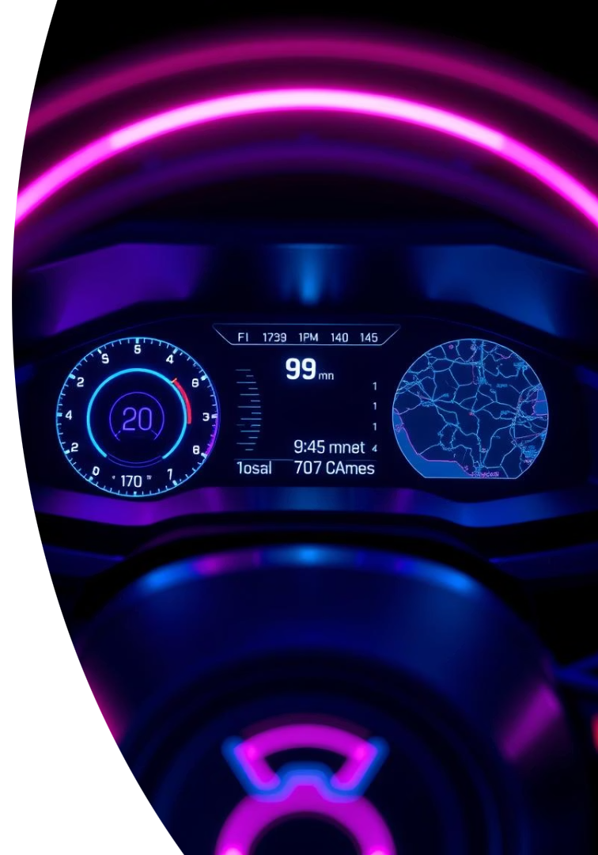
Analyzing the Selling Price of Used Cars Using Python
A Data-Driven Approach to Price Prediction
Prakhar Singh
Raj priyanshu
Gagan Sharma

Slide 2





Introduction: The Importance of Used Car Pricing
The global used car market was valued at $1.4 trillion in 2023. Accurate pricing benefits both buyers and sellers in this vast market.
Market Size
A $1.4 trillion global market in 2023.
Fair Pricing
Ensures transparency for buyers and sellers.
Our Objective
Predict prices using Python and machine learning.
Key Factors
Make, model, year, mileage, condition, location.

Slide 3





Data Collection and Preparation
Data acquisition is the first crucial step in our analysis. We source datasets from reputable platforms.
Dataset Sourcing
From Kaggle, Edmunds API, or web scraping.
Example: Kaggle's "Used Cars Dataset" with 3M+ listings.
Variable Identification
Key variables: Price, Year, Manufacturer, Model, Mileage, Condition.
Also Cylinders, Fuel, Odometer, Transmission, and more.
Data Cleaning
Handle missing values, outliers, and inconsistencies.
Ensures data quality for accurate predictions.
Feature Engineering
Create new variables like car age and mileage bands.
Convert categorical features using one-hot encoding for modeling.

Slide 4
Exploratory Data Analysis (EDA)
EDA helps us understand the underlying patterns and relationships within the data. Visualizations reveal insights.
Price Distributions
Feature Relationships
Correlations
Histogram and KDE for car prices.
Scatter plots: Price vs. Year and Mileage.
Heatmap of correlation matrix.
Identify common price ranges.
Shows variable interdependencies.
Box plots: Price vs. Make/Model.

Slide 5





Model Selection and Training
Choosing the right machine learning model is critical for accurate price prediction. We evaluate several algorithms.
Algorithm Choice
Linear Regression, Random Forest, XGBoost.
Performance Metrics
RMSE and R-squared for evaluation.
Data Split
80% training, 20% testing data.
Hyperparameter Tuning
Grid search with cross-validation.

Slide 6

Key Findings and Insights
Our analysis reveals important factors influencing used car prices and market trends. These insights are crucial.
Influential Factors
Mileage, year, and model are most impactful.
Depreciation Rates
Annual depreciation varies by car type.
Luxury brands often depreciate faster.
Condition Premium
"Excellent" condition cars command 15% more.
Geographical Impact
Regional price differences due to local demand.

Slide 7
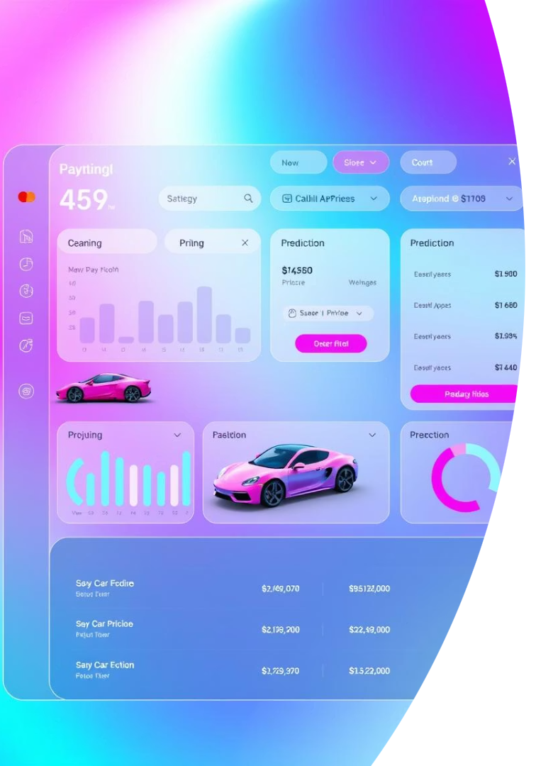
Visualization and Interpretation
Visualizing our model's performance helps us understand its accuracy and the importance of various features. It clarifies complex data relationships.
Prediction Accuracy
Scatter plot of predicted vs. actual prices.
Residual analysis shows error distribution.
Feature Importance
Bar chart highlighting influential variables.
Explains which factors drive price.
Interactive Tool
Dashboard for user input and price prediction.
Visualize predictions for different models easily.

Slide 8








Conclusion and Future Work
Our model provides valuable insights into used car pricing dynamics. It offers practical applications for both buyers and sellers.
Summary of Findings
Practical Applications
Key drivers of used car prices identified.
Used as a pricing guide and negotiation tool.
Model performance is robust.
Future Improvements
Call to Action
Incorporate more data and advanced models.
Utilize data-driven insights for informed decisions.
Enable real-time price updates.

